Slide 1

Analysis for opening Whole Sale Store for Food Products
APPLIED DATA SCIENCE CAPSTONE
Mahesh Venkat Reesu

Slide 2
Problem Description
Finding the best location for constructing(opening) a Wholesale Store for raw materials used in preparation of Food Stuffs in Brooklyn.
This project aims to predict location of establishing a store in Brooklyn based on the dataset and visualise the clusters and analyse the customers. Obviously, all famous Restaurants, Factories and Stores are interested in doing business with whole sale retailers.

Slide 3
Data Description
We will need geo-locational information about that specific borough
The neighborhoods in that borough from Foursquare API.
We assume it is “Brooklyn".
Data is cleaned and stored in a Data Frame for processing and visualizing.

Slide 4
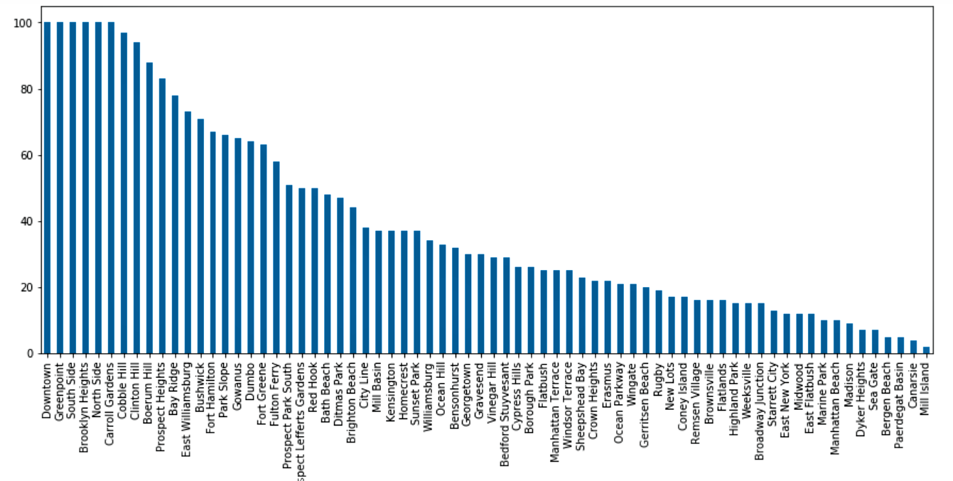
Analysis of Venues
Number of Venues in each neighbourhood (Sorted).

Slide 5
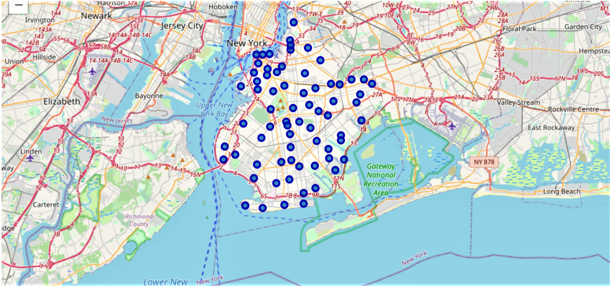
Visualising Neighbourhoods on map

Slide 6
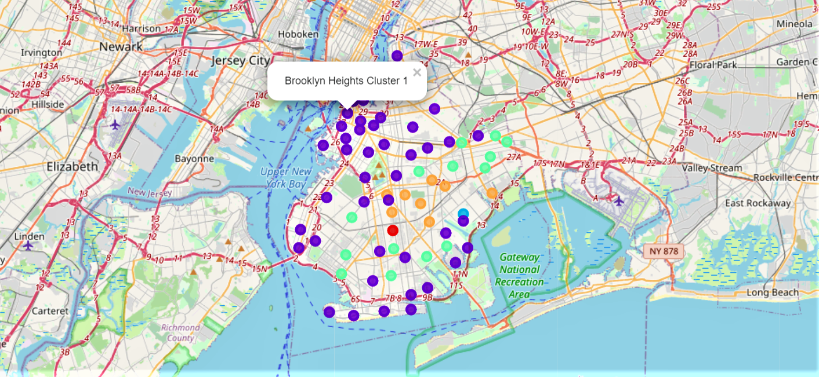
Results
Visualizing Clusters on Map

Slide 7
Conclusion
From the map we can say that the cluster one is suitable for business.
Moreover, most the popular venues are located in this cluster.
Down Town is located in upper part of cluster 1 and is nearer to New York and Harbour which is suitable for easy shipping of goods

Slide 8
Limitations
Predicted location doesn’t show exact coordinates as availability of construction site data is available in taken data set.
Hence, the accuracy of data depends purely depends on the data provided by FourSquare.

Slide 9
THANK YOU
____________________________________

